Slide 1

MOVIE REVIEW APP
Proceed forward to find the best possible recommendations!

Slide 2
INDEX:
Mercury
Venus
Mercury is the closest planet to the Sun
Venus is the second planet from the Sun
Jupiter
Saturn
Jupiter is the biggest planet of them all
Saturn is composed of hydrogen and helium

Slide 3
INTRODUCTION:
Finding media to watch takes a long time and more often than not consumes more time than the time spent watching it. Our system helps save time for users by recommending movies, tv shows, etc. to watch that is similar in genre, ratings, etc. to the type of media the user likes to watch.

Slide 4
SCENARIO FOR IMPLEMENTATION:
People watch various tv shows, movies, etc. But at the same time they spend a lot of time surfing the net to find the perfect show for them. Our system will help to save the users time by providing them with the perfect show for them which will be based on the choices chosen by the users in our system.

Slide 5
PROBLEM DEFINITION:
Our recommendation system takes user's media consumption data such as previously watched movies, tv shows, etc, and their likes and dislikes and based on this data it recommends similar media that the user may like. It then allows the user to rate the recommendations and based on the rating, tries to improve the recommendations further.

Slide 6
SCOPE OF THE PROJECT:
This system will help to provide users with with the freedom of choice of watching shows, movies etc which are similar to their taste.
This will save time of the users since they won't have to surf the net for new shows, movies, etc.

Slide 7
REQUIREMENTS:
Modules for : Assists user with movies,tv-shows,etc recommending them with the top grossing ones and updating the recommendations based on their choices.
Provide a user friendly website for fulfilling the above module.
Provide assistance to use this software and also prevent any inconsistency in the operations.

Slide 8
SYSTEM DESIGN:
Finding media to watch takes a long time and more often than not consumes more time than the time spent watching it. Our system helps save time for users by recommending movies, tv shows, etc. to watch that is similar in genre, ratings, etc. to the type of media the user likes to watch. People watch various tv shows, movies, etc. But at the same time they spend a lot of time surfing the net to find the perfect show for them. Our system will help to save the users time by providing them with the perfect show for them which will be based on the choices chosen by the users in our system.

Slide 9
SYSTEM DESIGN(CONTINUED):
Our recommendation system takes user's media consumption data such as previously watched movies, tv shows, etc, and their likes and dislikes and based on this data it recommends similar media that the user may like. It then allows the user to rate the recommendations and
based on the rating, tries to improve the recommendations further.
This system will help to provide users with the freedom of choice of watching shows, movies etc which are similar to their taste.
This will save time of the users since they won't have to surf the net for new shows, movies, etc.

Slide 10
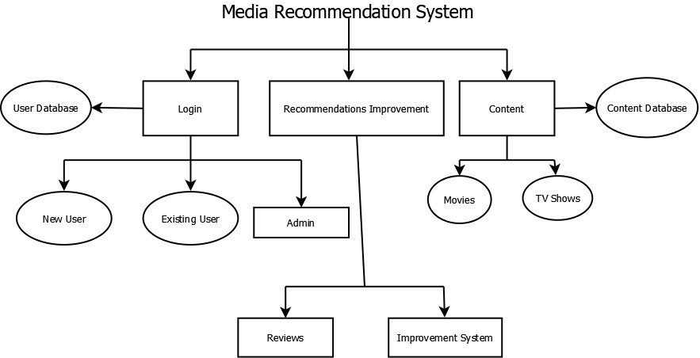
System Architecture:

Slide 11
OUR FOCUS:
Login
This page is for the users to signup/login in the website. This page prevents unauthorised access to the website.
Recommendations Improvement
The users are provided with recommendations ranging from a wide variety of movies and tv shows. Based on their choices the recommendations are also updated in a manner which suits them.

Slide 12
OUR FOCUS:
Dashboard
After logging in, the center of the screen, the movies and tv shows are recommended to the users. The navbar on the left side consists of 5 options namely(from the top)-Dashboard, Bookmarks(consists of the movies and tv shows liked by the user), The arrow(tells us about the top 250 movies and tv shows in a whole), the next icon gives the recommendation of the top 250 movies and the last icon gives the recommendation of the top 250 shows.
The navbar on the right side consists of 5 options namely(from the top)- User Profile, A icon which on clicking will dynamically change the colour of the webpage based on the predominant colour on the movie poster, the favourites icon on clicking will add the movies/tv shows selected to the bookmarks, the last icon is for logout.

Slide 13
Module wise flow diagram:
1. Login:

Slide 14
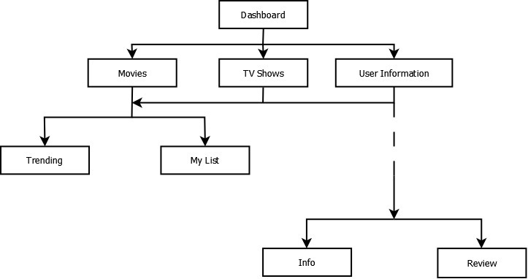
MODULE WISE FLOW DIAGRAM:
2. Dashboard:

Slide 15
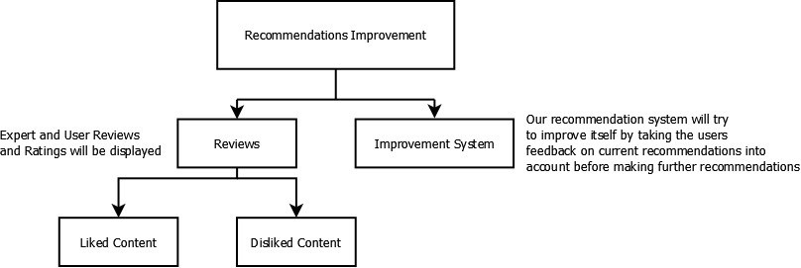
MODULE WISE FLOW DIAGRAM:
Recommendations improvement:

Slide 16
Programming languages used:
modularity and structuring; We will be using Python and Flask as a backend for our website to add modularity and structure.
headers and commenting; Headers and commenting will be provided within the python backend code
indenting and layout; We will be using HTML and CSS for the layout and structure of our website
library routines to be used; We will be using python’s flask, pandas and beautiful soup libraries to help implement the algorithms and backend
language constructs to use; We will be using the basic python language constructs of keeping the code simple, clean, and easily readable.
language constructs to avoid. We will be avoiding using too many python libraries which will make our project more portable and easy to run everywhere.

Slide 17
Software development tools:
an application development too;
b. HTML authoring tools;
c. a word processor for documentation;
d. a tool for drawing diagrams;
e. automated testing tools.

Slide 18
FRONT END WEB PAGES:
The Frontend has been created using HTML, CSS, JavaScript and AJAX. It dynamically fetches the latest data from Flask /stream URL using XMLHttpRequest and updates the data on the browser side instantaneously using JavaScript.
The users responses like asking for the next recommendation, liking a movie/show or disliking it are transmitted to the Flask backend using AJAX.
The index page is the dynamically updating page that constantly changes as new recommendations are received.
The top media page, top movies page and top shows page show the top 250 of their kind and that list is changed when the database is updated.
The watchlist page contains the users liked movies and tv shows so that the user can access the list anytime and see which movies/tv shows they have saved for later.

Slide 19
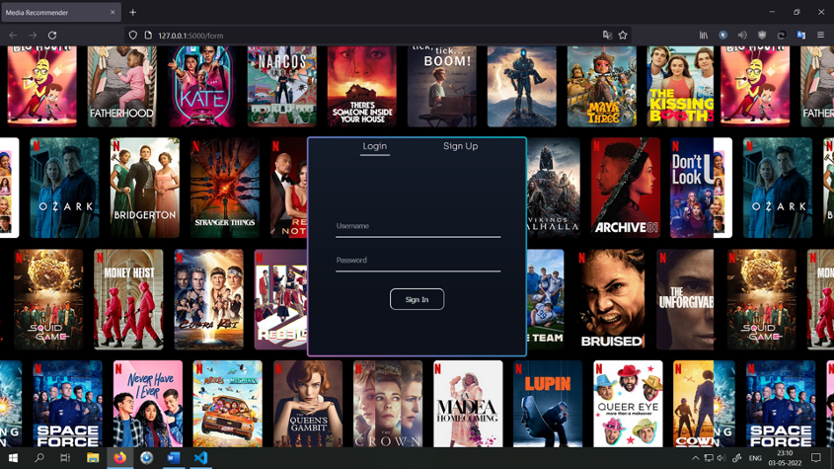
FRONT END WEB PAGES:
Login Page:

Slide 20

FRONT END WEB PAGES:
Signup Page:

Slide 21
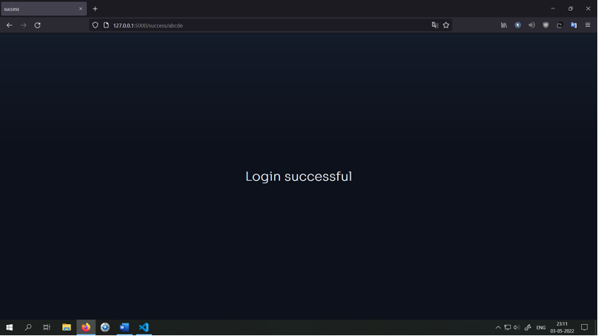
FRONT END WEB PAGES:
Login Successful Page:

Slide 22
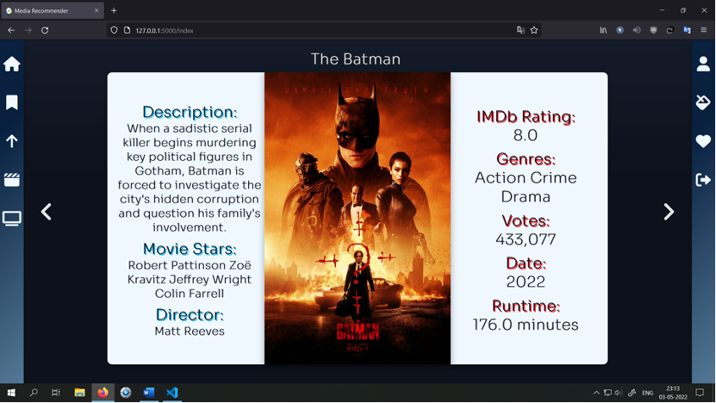
FRONT END WEB PAGES:
Home Page:

Slide 23
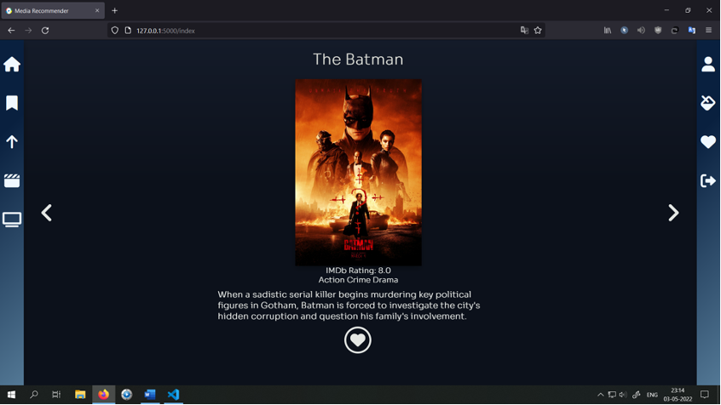
FRONT END WEB PAGES:
Alternative Home Page:
This can be toggled by clicking on the thumbnail/image of the movie or tv show

Slide 24
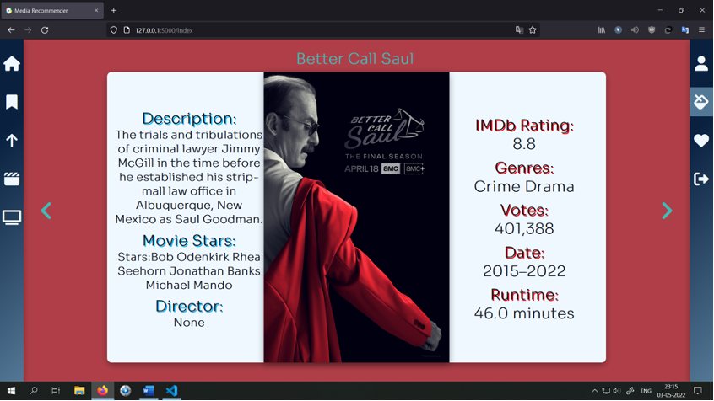
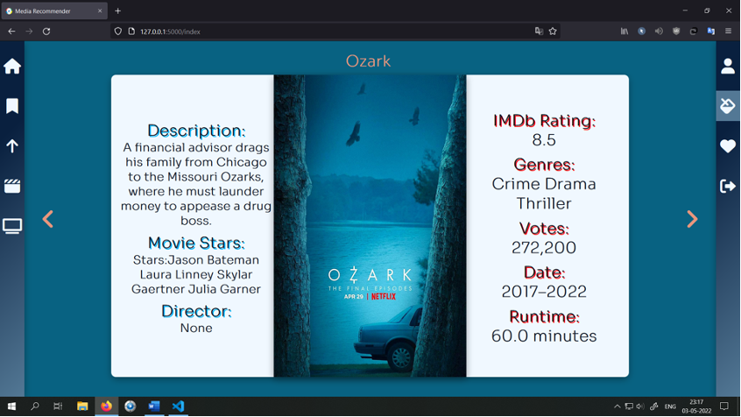
FRONT END WEB PAGES:
Home Page with Colour Picker Selected:
The colour bucket on the right-hand side can be used to toggle this effect. If active, the colour of the background and the text on the page are altered on the basis of the major accent colour of the thumbnail.

Slide 25
FRONT END WEB PAGES:
The next and previous buttons on the homepage are used to go to the next media recommendation.
The navbars on the left and right contain useful functions/ links.
On the left navbar, there is the home button, watchlist button, top movies+shows button, top movies button and top shows button in that order from top to bottom.
On the right navbar are present the button for the profile page, the coloured background page, the like button and the logout button.
The like button is used to add the movie/show to your watchlist and to get new recommendations based on that like.

Slide 26
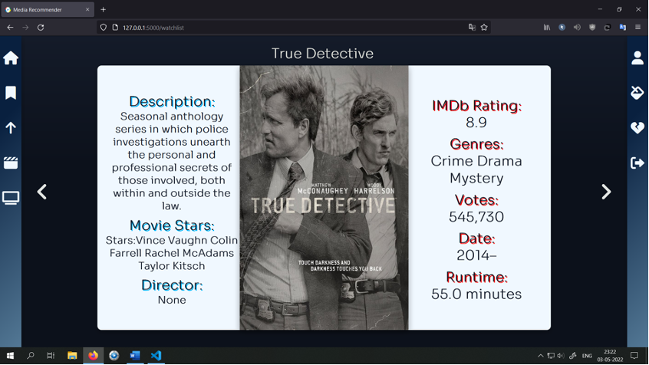
FRONT END WEB PAGES:
Watchlist Page:
You can scroll through all your liked media and the dislike button present on the right is used to remove the media from the list. The recommendations on the home page are updated accordingly.

Slide 27
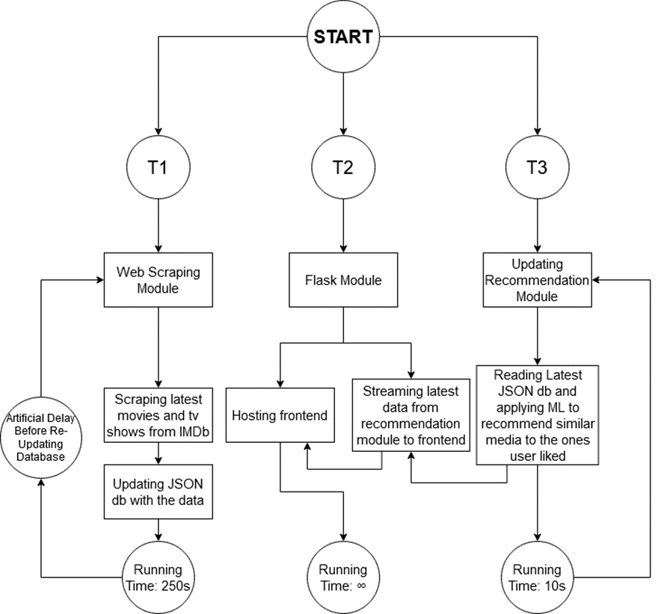
BACK END WEB PAGES:

Slide 28
BACK END WEB PAGES:
1) Database:
The database of our system is stored in a json format. We have 5 json files that handle the database needs of our system:
· Media.json: This file contains all the information on various movies and tv shows like the Title, Description, Thumbnail, Date, Genres, Rating, Votes, Director, Actors and Runtime for the Top Movies and Tv Shows scraped from IMDb. The database contains the url of the thumbnail from which the thumbnail is retrieved and displayed on the webpage at the time of execution.
· Movies.json: This file contains all of the information like the Title, Description, etc. mentioned above but for only the Top Movies.
· Shows.json: This file contains all of the information like the Title, Description, etc. mentioned above but for only the Top Movies.
· Users.json: This contains the user registration and login information like their Name, Username, Email and password which are stored upon successful registration and referred for validation when a user tries to login.

Slide 29
BACK END WEB PAGES:
2) Scraping:
The IMDb URL from which data is scraped is
https://www.imdb.com/search/title/?title_type=feature,tv_series&count=250
We utilize selenium, firefox webdriver, beautiful soup and lxml parser to scrape the information from the URL. Selenium is used to retrieve the content from the URL. Since IMDb employs a lazy loading strategy, we need to scroll the content of the entire webpage using selenium and the firefox/chrome webdriver. The webdriver is run in a headless mode which causes the Firefox Browser to open silently in the background, perform the operation and close without opening any sort of GUI. It takes about 70 seconds to scroll the entire webpage and load all of the data in the page. We then perform the get request on the webpage and retrieve the contents of the entire webpage.
We then utilize beautiful soup and lxml to parse the data and retrieve the necessary information. It is processed with the help of Regex and stored in a pandas dataframe. The dataframe is then exported to the file media.json. Overall, it takes about 80 seconds to execute. Similarly the movies.json and shows.json are also updated which brings the execution time of the database update to about ~250 seconds.

Slide 30
BACK END WEB PAGES:
3) Flask:
Flask is used in our project for the purpose of hosting the frontend and streaming the latest data to the frontend. The validation and backend for User Login, Registration, Creation of Session has all been done using flask. There are four main URL’s created in flask for the purpose of streaming the data to the frontend: /stream, /response, /like, /dislike. In the frontend, JavaScript and AJAX have been used to send the id of the media for which we would like data to be streamed to the /response URL via a GET request. That id is then provided to the Stream function which retrieves the data of the id from the dataframe imported via the json db and then returns it. In the frontend XMLHttpRequest is then used to perform a request on the stream url and retrieve the data for displaying. JavaScript is used to update the data instantaneously on the browser side. Similar to the response url, when the user presses the like/dislike button on the frontend, the id is sent to the like/dislike urls which update the likes.json database and dataframe and are then used to update the recommendations.

Slide 31
BACK END WEB PAGES:
4) Recommendations:
The recommendations thread of our project takes the liked ids provided by the likes dataframe/database and tries to find similar media to recommend to the user. This is accomplished by performing Machine Learning on the data of the movies/tv shows which the user likes. We have implemented basic Language Processing on the Genre of the Media and its Description. For this purpose we have used the CountVectorizer and TFIDVectorizer functions provided by the Sklearn library. We have two functions genre-based recommender and content-based recommender which perform the ML tasks and return similar indices to the provided ids. We then merge the results using an algorithm which first appends the media present in both of the lists, then it appends the remaining media from the genre-based recommender and then finally the remaining media from the content-based recommender. The same algorithm is then applied to merge these results with the previous recommendations with the new list taking position of genre-based and the old recommendations taking the place of the content-based. The list is then provided to the flask module for streaming to the frontend.

Slide 32
BACK END WEB PAGES:
5) Multi-threaded Execution:
The main file of the project main.py contains the code for the multithreaded execution of the project. It has 3 threads running simultaneously during the execution of the program: Scraping and updating the database, Running Flask and Updating Recommendations. We have made a flowchart to demonstrate the flow of the threads.

Slide 33
Functions Implemented:
1) Scraping:
All the functions in scraper.py are contained in the Scraper Class.
I. __init__():
The constructor of the scraper class loads the Selenium Webdriver and gets the data from the url.
II. articleTitle():
This function parses the received data and returns the title of the page.
III. bodyContent():
This function parses the received data and returns the collection of <div> tags that contain the main data.
IV. mediaData():
This function iterates over and parses the <div> tags received from bodyContent() and after processing the data, stores it in a pandas dataframe and returns it.
V. main():
This function calls all of the above functions and after receiving the media info dataframe, stores it in the json db.

Slide 34
Functions Implemented:
2) Flask:
In flask_website.py, there are a total of 16 python functions each of which is bound to and corresponds to a particular path on the hosted backend on localhost. Several routes are defined using @app.route() function of flask and each of them has a bound function which renders the html pages, sets sessions, performs validations, redirects to another url, streams the data and alters database based on user response.

Slide 35
Functions Implemented:
3) Recommendations:
I. genreBasedRecommender():
This uses the CountVectorizer from Sklearn to process the genres of the media in the database and returns the list of indices it determines is similar to the provided index.
II. contentBasedRecommender():
This uses the TFIDVectorizer from Sklearn to process the descriptions of the media in the database and returns the list of indices it determines is similar to the provided index.
III. merge():
This function contains the implementation of the merging algorithm which combines the two lists provided to it. The explaination of the algorithm is provided in the implementation details.
IV. main():
This function calls all the above functions, and then uses the merging algorithm explained in implementation details to merge the recommendations with each other, then with the global recommendations list and the finally extend the global recommendations list.

Slide 36
Functions Implemented:
4) Multi-threaded Execution:
I. updateDB():
After set time intervals, it calls the main() function of the Scraper class which updates the db.
II. flask_app():
It executes the run function of flask.
III. recommender():
It calls the main() function of recommender.py and the updates the recommended_ids list of flask_website.py with the returned recommendations.
IV. main():
It creates three threads each of which is bound to one of the above functions and starts the execution of the multithreaded application.

Slide 37
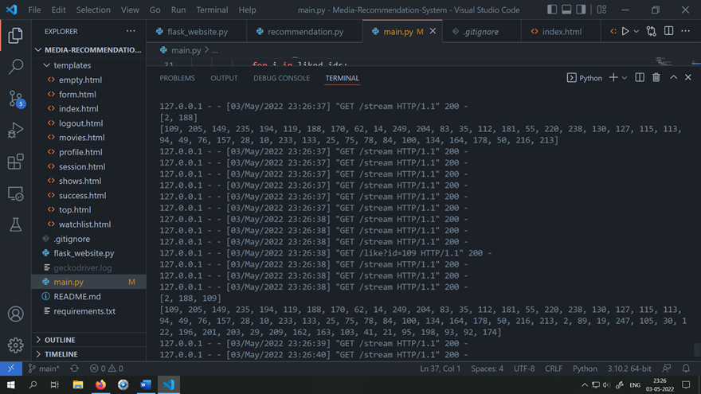
BACKEND(execution of flask and updating of recommendations based on addition to liked list):

Slide 38
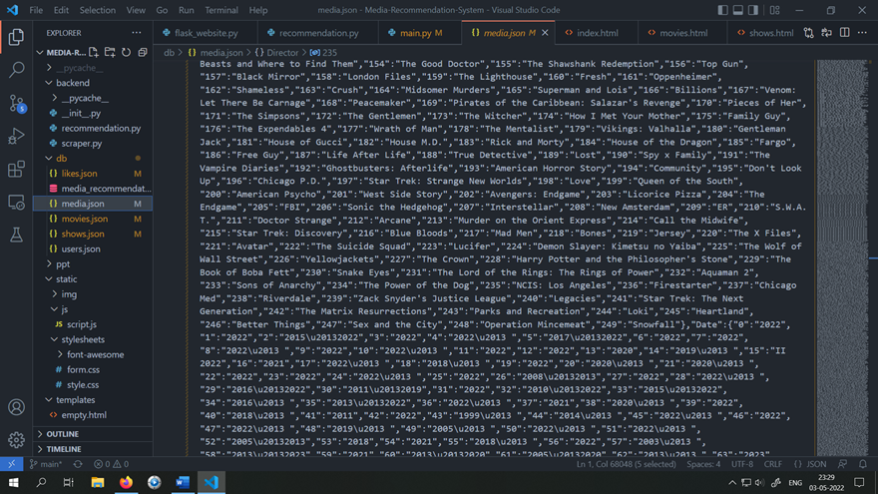
BACKEND(Media.json database:)

Slide 39
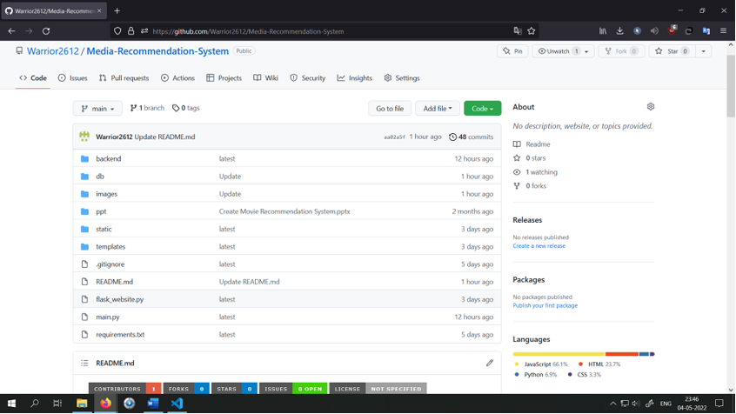
GitHub:
https://github.com/Warrior2612/Media-Recommendation-System

